Slide 1
From Scratch to Fine-Tuning: The Evolution of Deep Learning
An overview of the journey from custom model training to leveraging pre-trained models

Slide 2

Deep Learning
What impacts where the arrow will go?
Distance from target
Force of draw
Height from ground
Angle with respect to ground/target
Wind speed
Coriolis effect
Rotation of the earth
…
$$x=−1.2+0.07Force+2.7Distance∗x_{angle}∗z_{angle}$$
$$y=2.7+2.2Force+9.7Distance∗y_{angle}∗z_{angle}$$

Slide 3
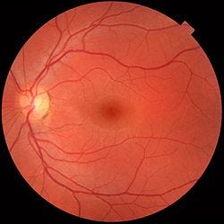
Deep Learning
Male
Female
Humans?
AI?

Slide 4
Deep Learning
Male
Female
Humans: No better than the flip of a coin
AI?

Slide 5
Deep Learning
Male
Female
Humans: No better than the flip of a coin
AI: 97% Accurate

Slide 6
Deep Learning
$$x= + Force+ Distance∗x_{angle}∗z_{angle}$$
Modern AI uses ~500 billion parameters
~ 4,121 on 8.5 x 11 paper
~ 121,340,662 sheets of paper
~ 485,362.648 inches tall (@ 0.004 inches/sheet)
= 40,446.887 feet or 7.67 miles high
Taller than Everest/Deeper than the Mariana Trench

Slide 7
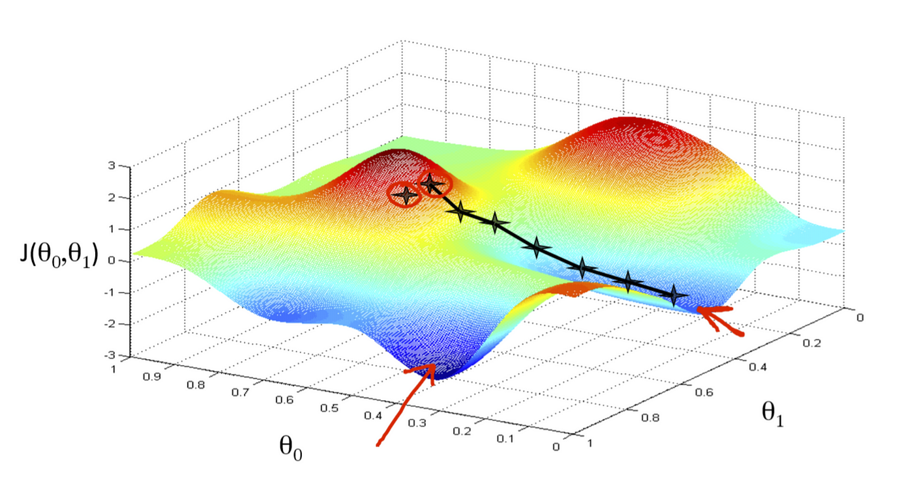
Optimization
Change the parameters until we minimize the times the model is wrong (or maximize the negative)

Slide 8
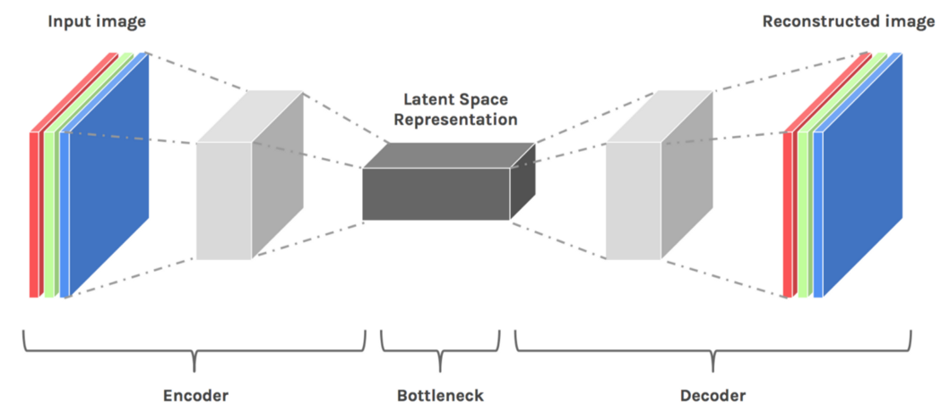
Latent Representations
Car
Human
Trashcan

Slide 9
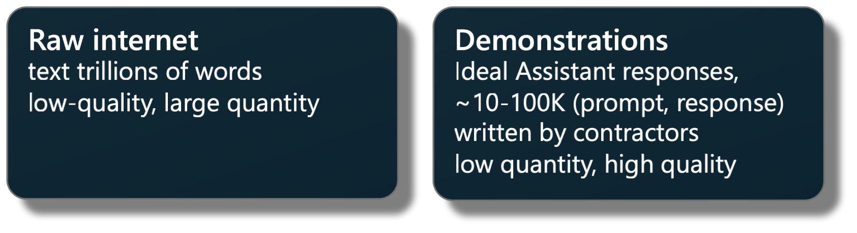
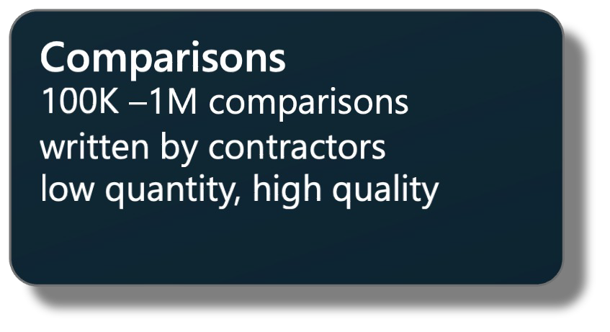
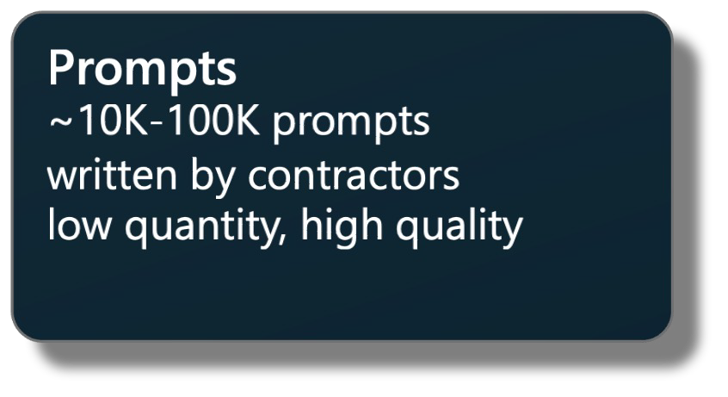














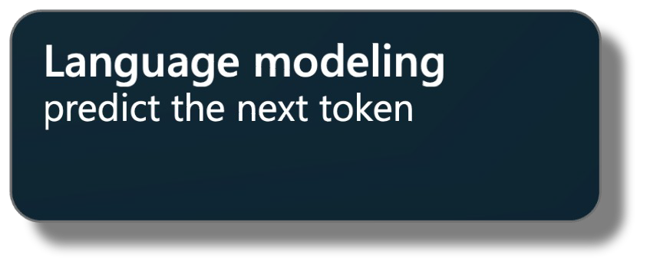
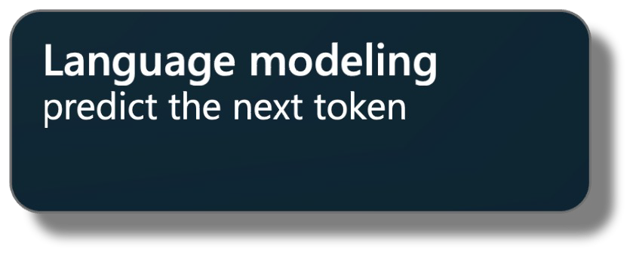
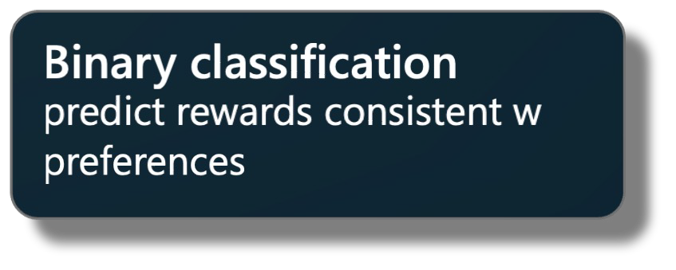
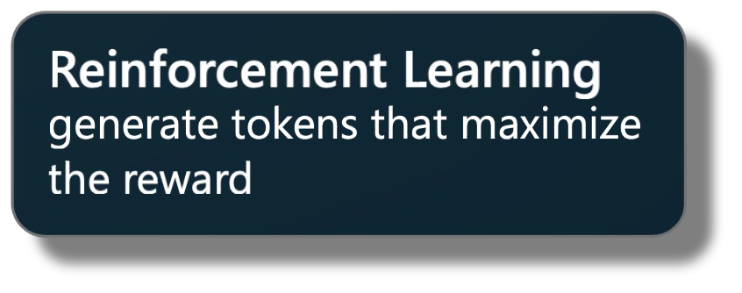

















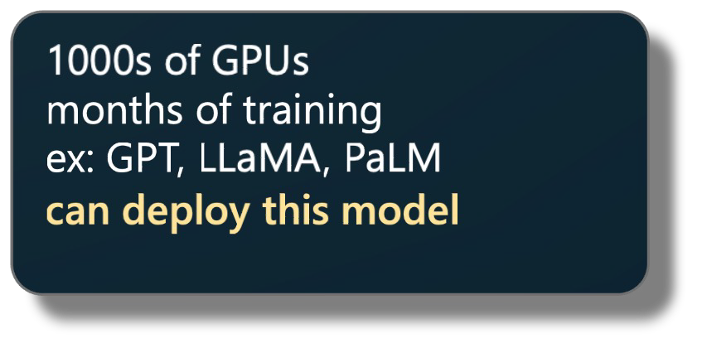
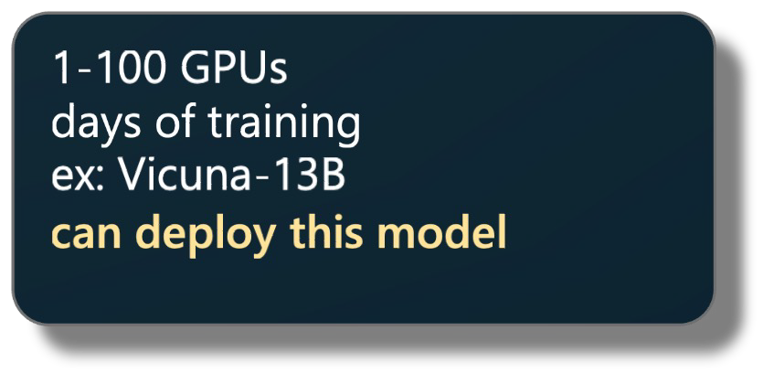
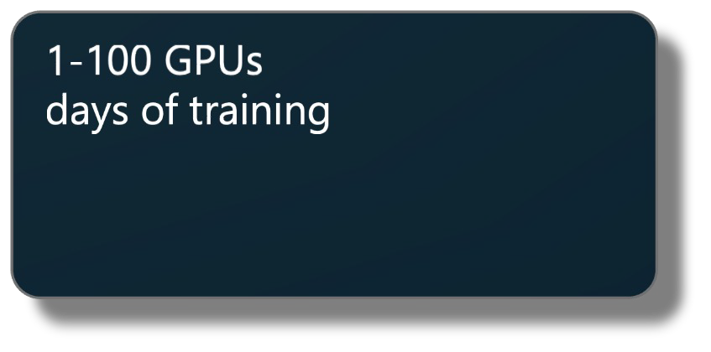
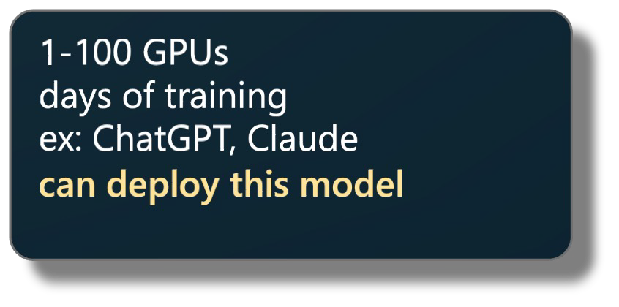
GPT Assistant training pipeline
Stage
Pretraining Supervised Finetuning Reward Modeling
Reinforcement Learning
Dataset
Algorithm
init from
init from
init from SFT use RM
Model
Notes
Notes:
4 main stages
Components of each stage

Slide 10



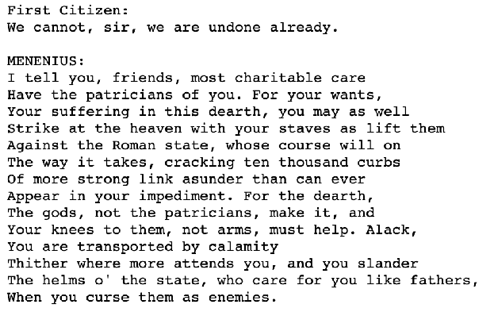
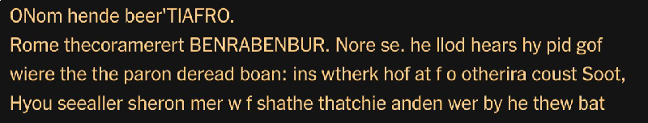


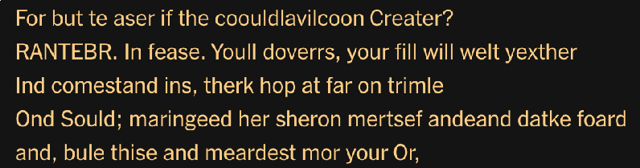

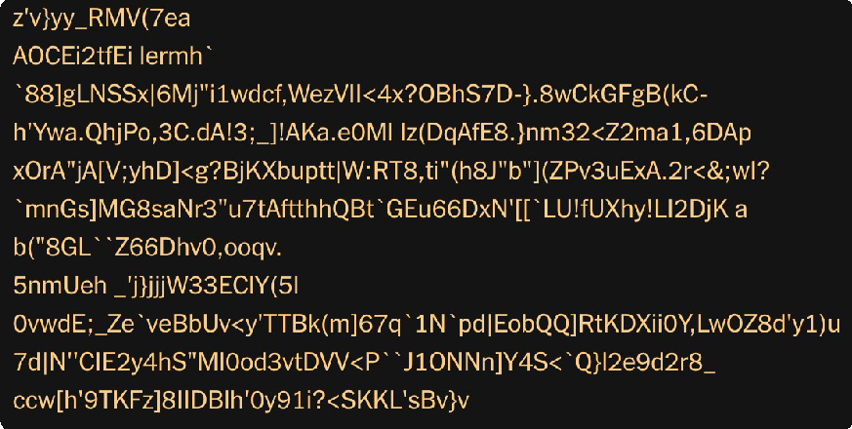

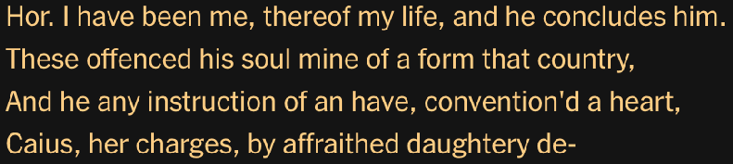

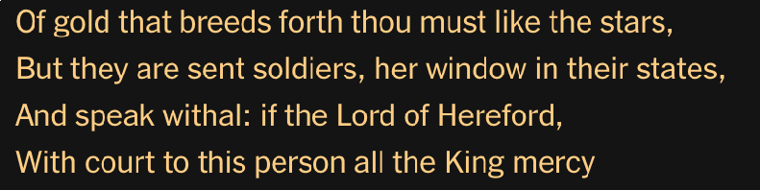


Training data (Shakespeare)
Samples after 250 iterations of training
Samples after 500 iterations of training
Training process
Samples at initialization
Samples after 5,000 iterations of training
Samples after 30,000 iterations of training

Slide 11
Latent Representations
Car
Human
Trashcan

Slide 12
Fine Tune for different objective

Slide 13
GPT Assistant training pipeline
Stage
Pretraining Supervised Finetuning Reward Modeling
Reinforcement Learning
Dataset
Algorithm
init from
init from
init from SFT use RM
Model
Notes
Notes:
4 main stages
Components of each stage

